Slide 1
Biodiversity Project:
Conservation Status Insights and Sheep Study Design

Slide 2
Table of Contents
Conservation Status Insights
Sheep Foot and Mouth Reduction Effort

Slide 3
Conservation Status Insights
Are different species more likely to be protected than others?

Slide 4
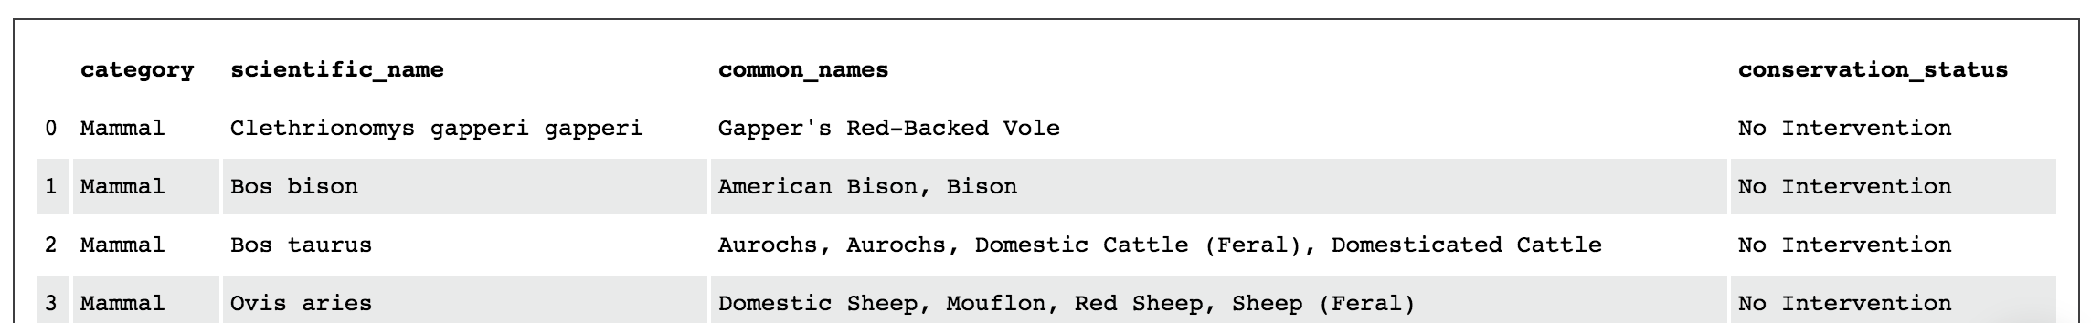
The National Park Service is tracking the conservation status of 5541 species
5541 species tracked

Slide 5
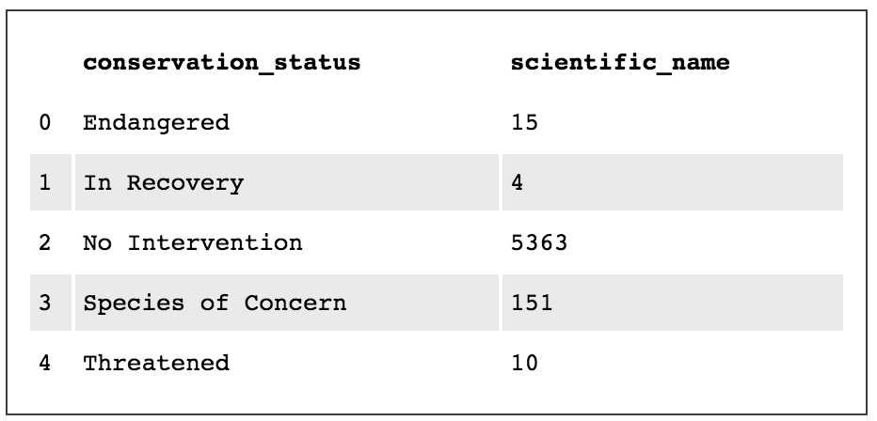
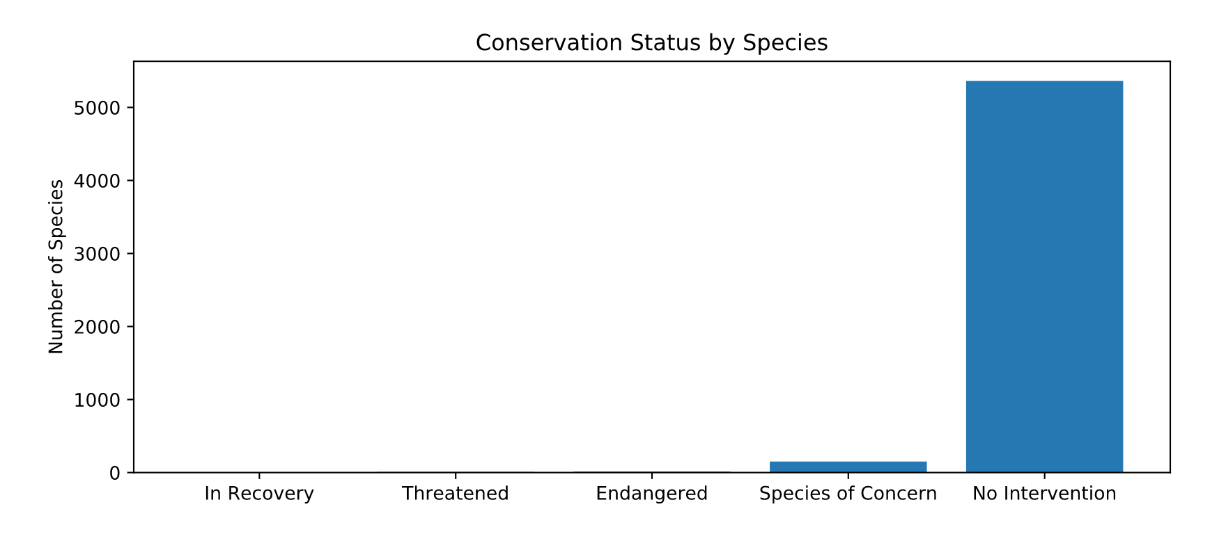
Interventions are currently underway for 3% of species

Slide 6
6-17% of animal species are protected. Certain types of species are more likely to be protected than others.
category | not_protected | protected | percent_protected
Amphibian | 72 | 7 | 9%
Bird | 413 | 75 | 15%
Fish | 115 | 11 | 9%
Mammal | 146 | 30 | 17%
Nonvascular Plant | 328 | 5 | 2%
Reptile | 73 | 5 | 6%
Vascular Plant | 4216 | 46 | 1%
The Chi-Squared Test shows that:
The difference between protected birds and mammals is insignificant and could be caused by chance
Mammals are more likely to be protected than reptiles
Recommendation:
Special efforts should be made to prevent more fragile species (e.g. birds and mammals) from entering protected status

Slide 7
Sheep Foot and Mouth Reduction Effort
How can we design a study to investigate foot and mouth disease in sheep within National Parks?

Slide 8
The National Park needs to design a study to test if an ongoing program to reduce foot and mouth is working in Parks’ sheep
Want to detect reductions of at least 5%
Last year, 15% of sheep had foot and mouth
The study should have 90% significance level

Slide 9
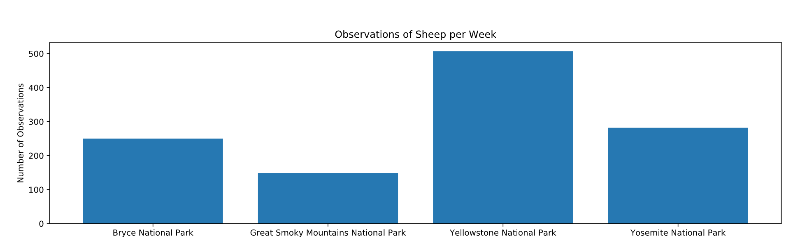
We can use current observations to design a study. 1,188 Sheep were observed across 4 National Parks over the last 7 days

Slide 10
We need a sample size of at least 890. It will take 2 weeks to observe enough sheep in Yellowstone or 4 weeks in Bryce

